Slide 1


Sales Insights - Data Analysis Project using Tableau
By – Vinay sahani
https://github.com/vinayykewat https://www.linkedin.com/in/vinay-sahani-775814274/

Slide 2
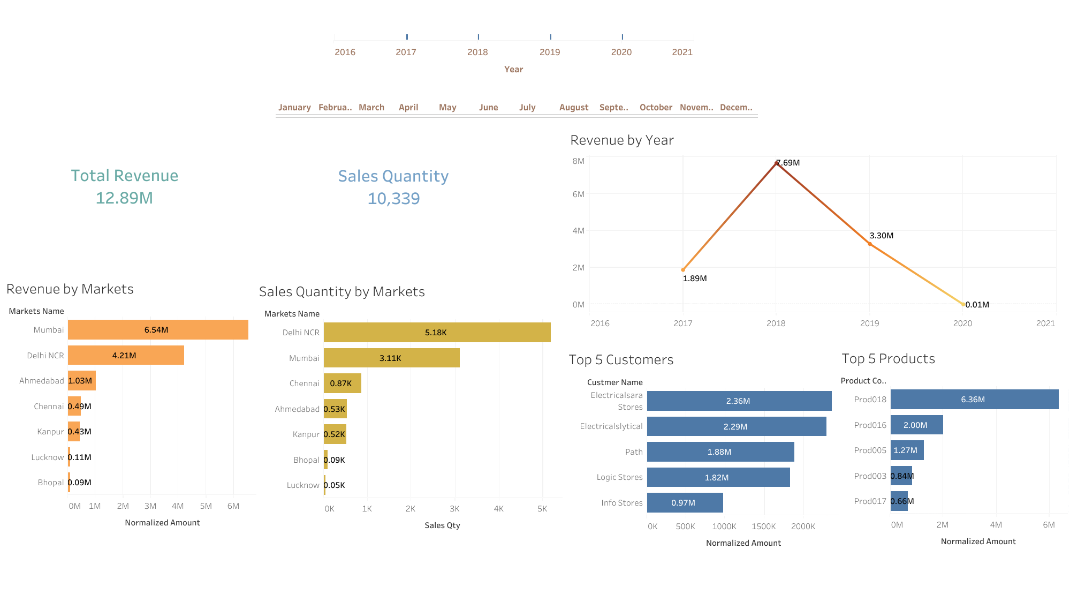

Slide 3
